Slide 1

Boundless Thinking Boundless Impact
Engineering a better future through the power of technology
May 2025

Slide 2

ResilientOps Web Application
May 2025

Slide 3
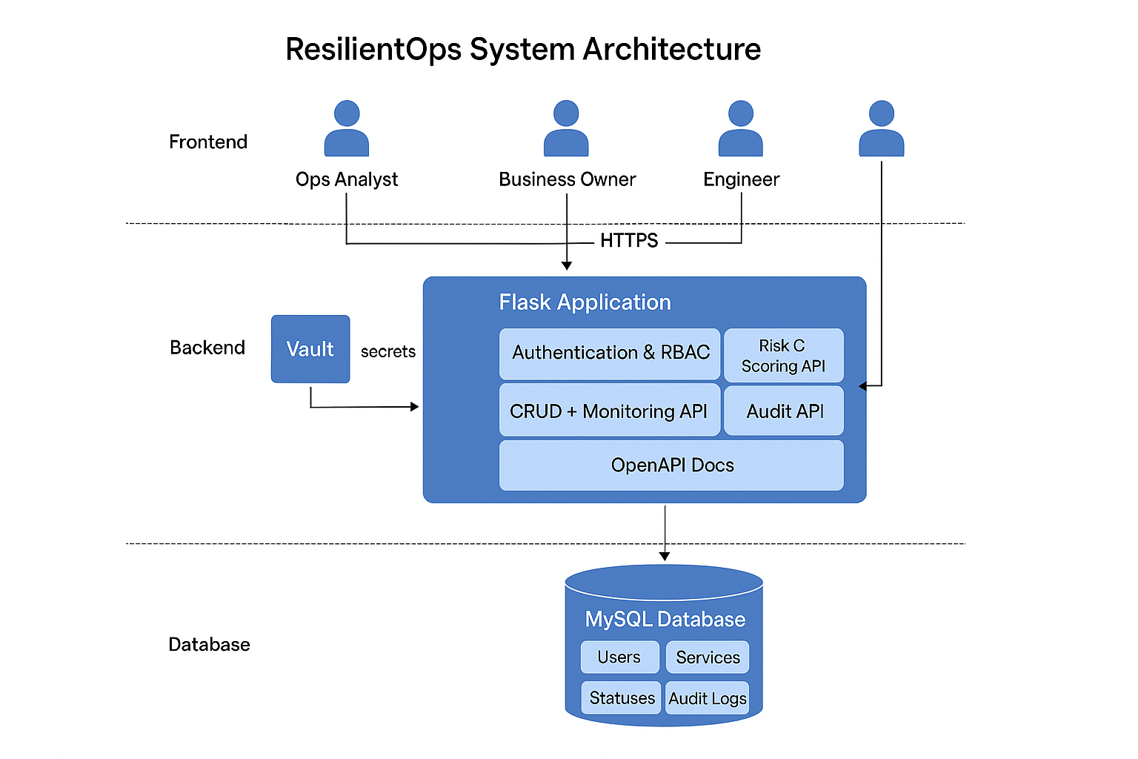
System Architecture : Overview

Slide 4
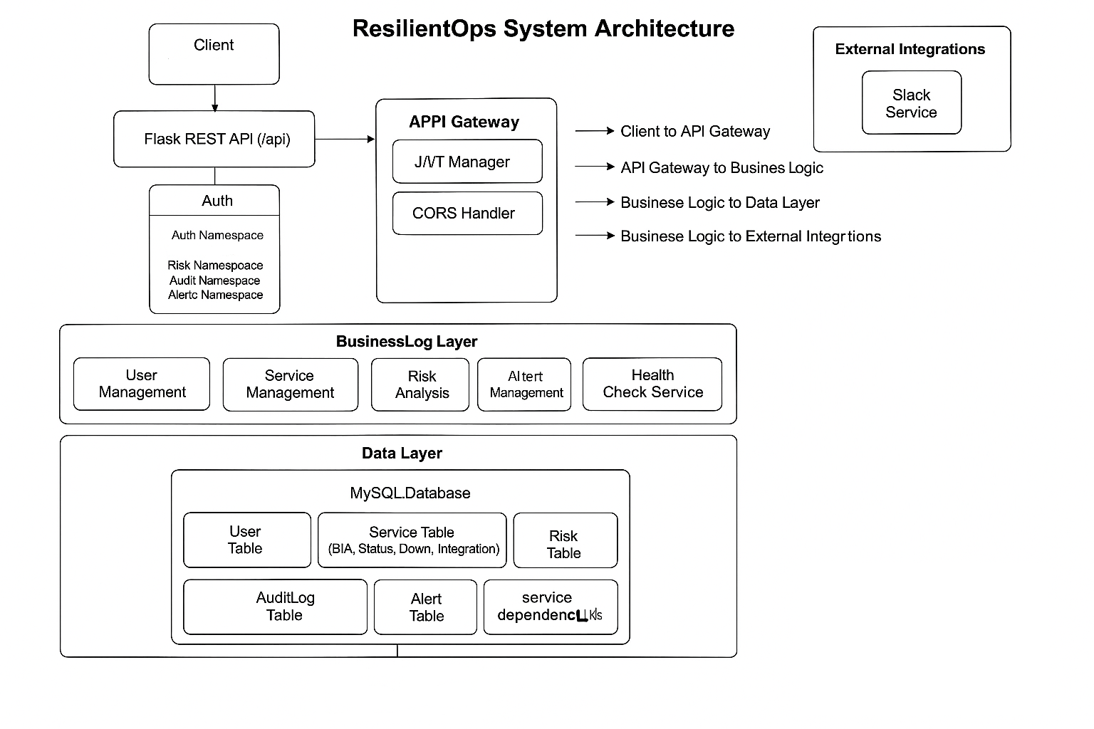
System Architecture : Layered

Slide 5
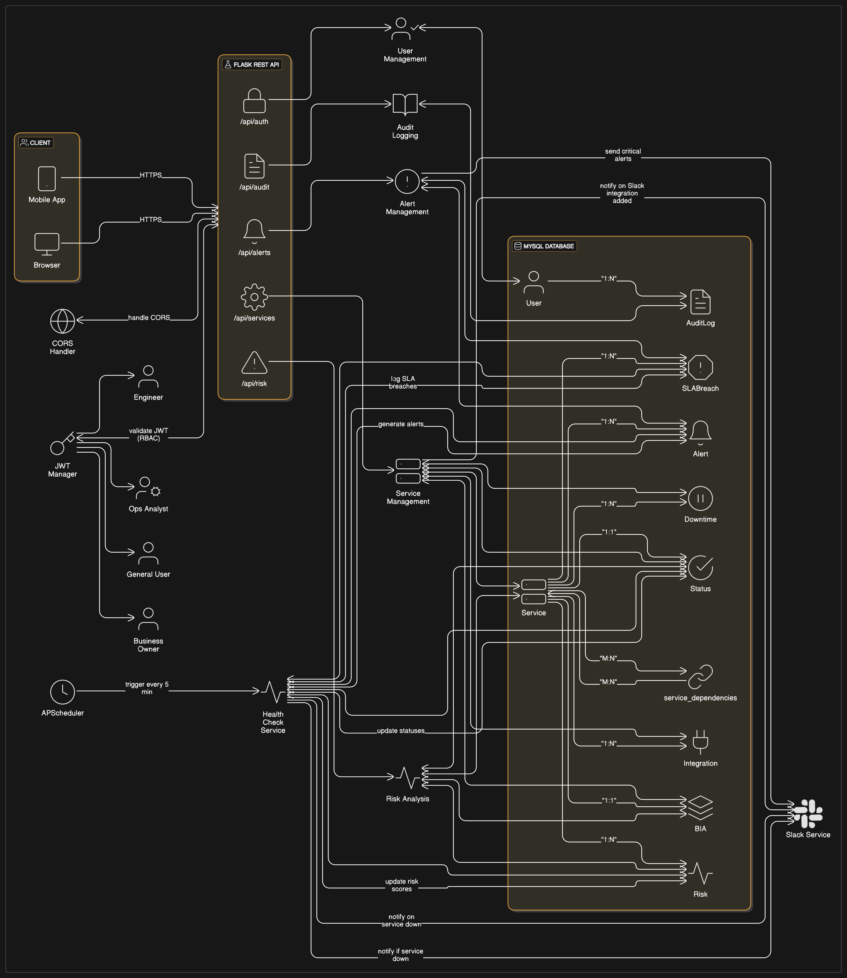
System Architecture : Final

Slide 6
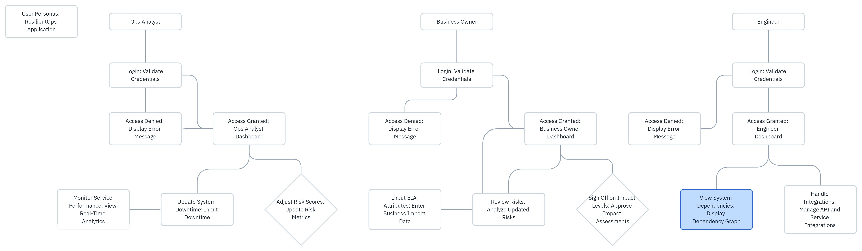
User Personas

Slide 7
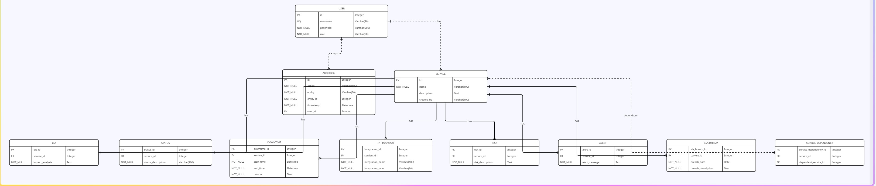
ER Diagram
https://miro.com/app/board/uXjVIzktN_4=/?moveToWidget=3458764628741192426&cot=14

Slide 8
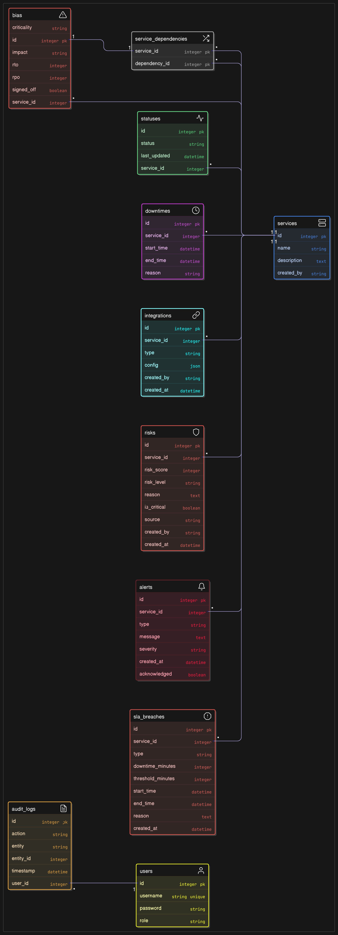
ER Diagram

